Slide 1
Nutrients
A substance that provides nourishment essential for the maintenance of life and for growth .

Slide 2
Q. How does energy utilized in the body?
it is used in active transport for absorption against the concentration gradient e.g. Absorption of amino acids and glucose in small intestine
It is used in mascular contraction and locomotion
It is used in transmission of nerve impulses
Used in formation of new protoplasm and repairing of worn parts
Used in growth and cell division
Used to maintain internal body temperature

Slide 3
7 nutrients
Carbohydrates
Proteins
Fats
Vitamins
Fiber
Mineral
water

Slide 4

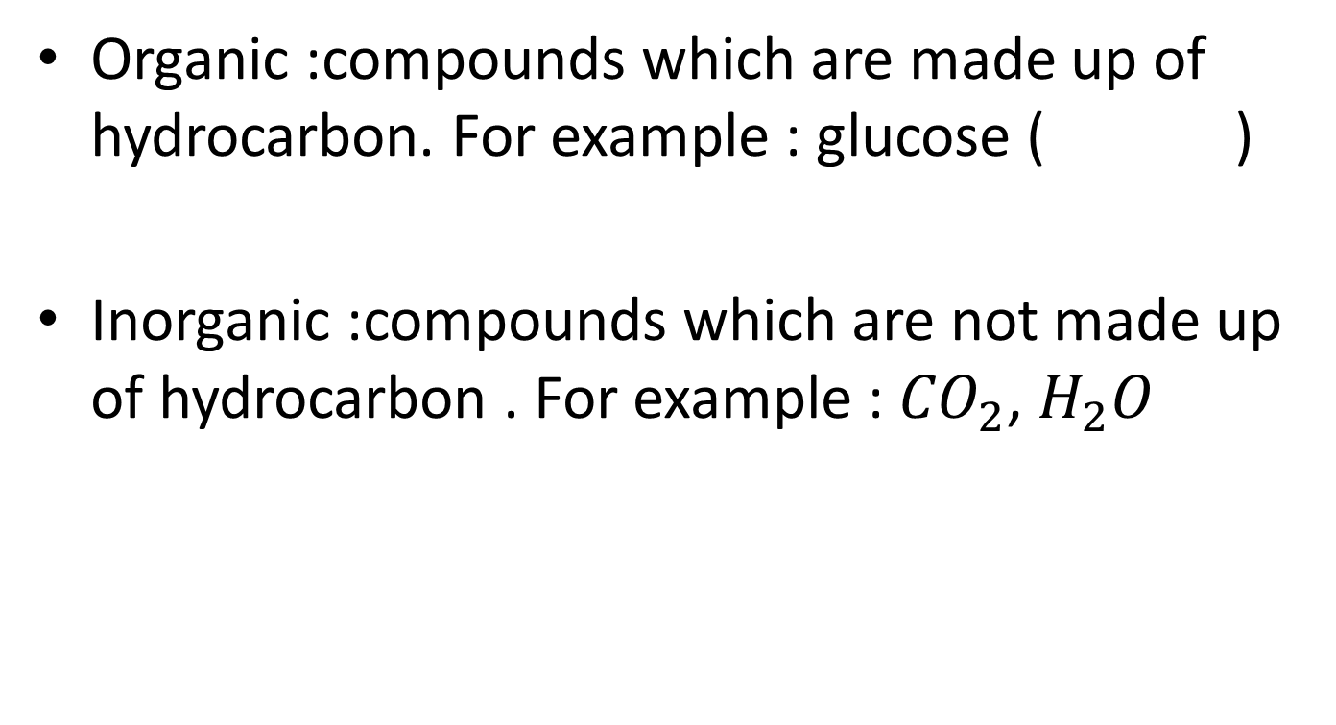
Types of compounds
Organic :compounds which are made up of hydrocarbon. For example : glucose ( )
Inorganic :compounds which are not made up of hydrocarbon . For example : ${CO}_{2}$, $H_{2}O$
$$C_{6}H_{12}O_{6}$$

Slide 5
Types of nutrients
Macronutrients :nutrients which are required in larger amount like carbohydrates, fats, proteins
Micronutrients :nutrients which are required in lesser amount like minerals

Slide 6

Carbohydrates
It is an organic compound made up of carbon, hydrogen and oxygen.
Hydrogen and oxygen exist as 2:1
For example : glucose ( )
$$C_{6}H_{12}O_{6}$$

Slide 7
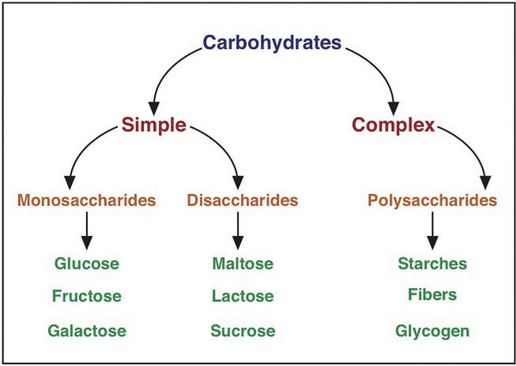

Slide 8
Monosaccharides
It is also known as simple sugar
Sweet in taste . Soluble in water
Can easily pass through cell membrane
All have same molecular formula C6H12O6 but different structural formula

Slide 9
Disaccharide
When two monosaccharides combine together with the release of water, a disaccharide is formed
glucose +glucose → maltose + water
Glucose +fructose → sucrose+water
Glucose +galactose → lactose + water

Slide 10
Properties of Disaccharide
Sweet in taste . Soluble in water
Cannot pass through cell membrane
All have same molecular formula C12H22O11 but different structural formula
All monosaccharide and disaccharide are called reducing sugar except sucrose.

Slide 11
Condensation
The formation of large molecule from small simple molecules with the release of water is known as condensation
Hydrolysis
The breakdown of large complex molecules into small simple molecule with the addition of water is called hydrolysis .

Slide 12
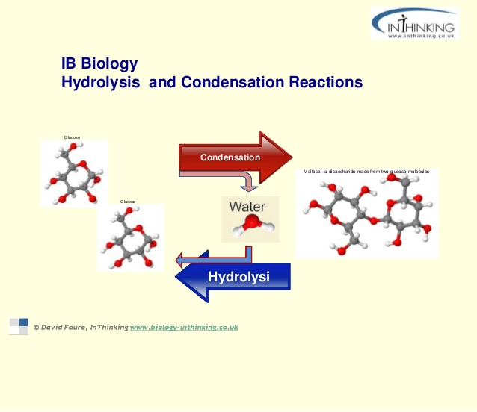

Slide 13
Polysaccharide
Formed when more than two monosaccharide combine together with the release of water
They are tasteless. Insoluble in water
Cannot cross the cell membrane

Slide 14
Importance of carbohydrates
As a source of energy
Used for the formation of cell wall
To be converted into different food substances like amino acids and fats
Used for the formation of nucleic acid e.g. DNA or RNA
Used for the formation of nectar in flowers to attract insects

Slide 15
Test for reducing sugar
Add 2 cm3 of reducing sugar in a test tube and add Benedict solution and heat . Initial color is blue but if reducing sugar is present it turns into brick red / orange. Otherwise it remains blue .

Slide 17
Protein
Compounds made up of carbon , hydrogen , oxygen and nitrogen.
Basic unit is amino acids .
Source : meat , egg white ,milk, fish, cereals, peas, beans etc
Function :
used for growth , repairing of tissues
Formation of new protoplasm
Used for the formation of enzymes and antibodies
Used for the formation of hormones
Deficiency
Stunted growth
Slow repairing of tissues
Lack of enzymes
Weak muscles

Slide 18
Kwashiorkor
Symptoms of kwashiorkor include:
Change in skin and hair color
Fatigue
Loss of muscle mass
Swelling of ankles and feet
Irritability

Slide 19
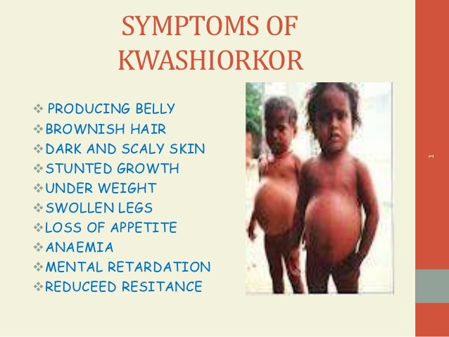

Slide 20
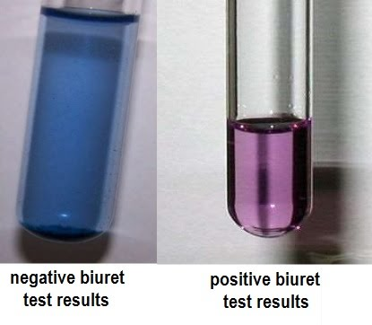
Test for proteins
Add 2 cm3 of proteins in a test tube and add biuret solution . Initial color is blue but if protein is present it turns into purple/violet .Otherwise it remains blue

Slide 21
Lipids/ fats
Made up of carbon , hydrogen and oxygen .
3 fatty acid + 1 glycerol → fat + water
            → + water

Slide 22
Sources of fats :
Butter, cheese, milk, egg yolk, red meat,nuts vegetable oil i.e. olive oil, castor oil, sunflower oil, etc.
Function :
Used as a source of energy
Essential for the formation of cell especially for cell membrane
Stored beneath the skin in adipose tissue which acts as an insulator of heat and prevent excessive water loss.

Slide 23
Saturated fats
Mostly obtained from animal food sources
Solid at room temperature e.g. ghee
Unhealthy fats may result in deposition of cholestrol within arteries creating a risk of heart disease.
Unsaturated fats
Mostly obtained from vegetable food sources
Liquid at room temperature e.g. oil
Mostly healthy fats :which do no increases the risk of heart disease
effects of taking excessive fats :
Heart attack
Joints pain
Obesity
Increase in blood pressure

Slide 24
Test for fats
Add 2 cm3 of oil in a test tube and add ethanol .add some water in it . Initial solution is clear but if fats are present it turns into milky white/ cloudy Solution

Slide 25
Water
Function
Keep us hydrated
The medium in which various chemical reaction of an organism occur .
A transporting agent for :
  Digested food substances from intestine to other parts of body
  Excretory products from the tissue cells to the excretory organs
It helps to regulate body temperature
It is the main raw material for photosynthesis .
Deficiency
Dehydration

Slide 26
Nutrients | Test/ reagent | Initial observations | Results | Heat required | Water required
Reducing sugar | Benedict test | Blue | Brick red | Y | N
Proteins | Biuret test | Blue | Violet | N | N
Fats | Ethanol emulsion | Clear | Milky white | N | Y
starch | Iodine solution | Yellow brown | Blue black | N | N

Slide 27
MICRO NUTRIENTS
Nutrients | Sources | Function | Deficiency | Symptoms
Vitamin C | Citrus fruits e.g lemon , oranges , green vegetables , spinach | Development of gums and teeth , proper development of skin , Promotes development of connective tissues | Scurvy | Bleeding gums , dry and scaly skin
Vitamin D | Milk and dairy products , fish egg yolk, green vegetables | Make bones strong | Rickets | Soft and spongy bones /brittle bones bowed legs
Calcium | Milk , meat , fruits | Make bones strong , make teeth healthy ,necessary for blood clotting | Rickets | Weak teeth , soft and spongy bones
Iron | Red meat , liver of goat , fish | Synthesis of hemoglobin , muscles strength , strong joints | Anemia | Depression , spot around eyes , fatigue , weakness ,
Roughages (Fibre) | Green vegetables , banana , cereals | Proper working of digestive system | Stomach cancer | constipation

Slide 28
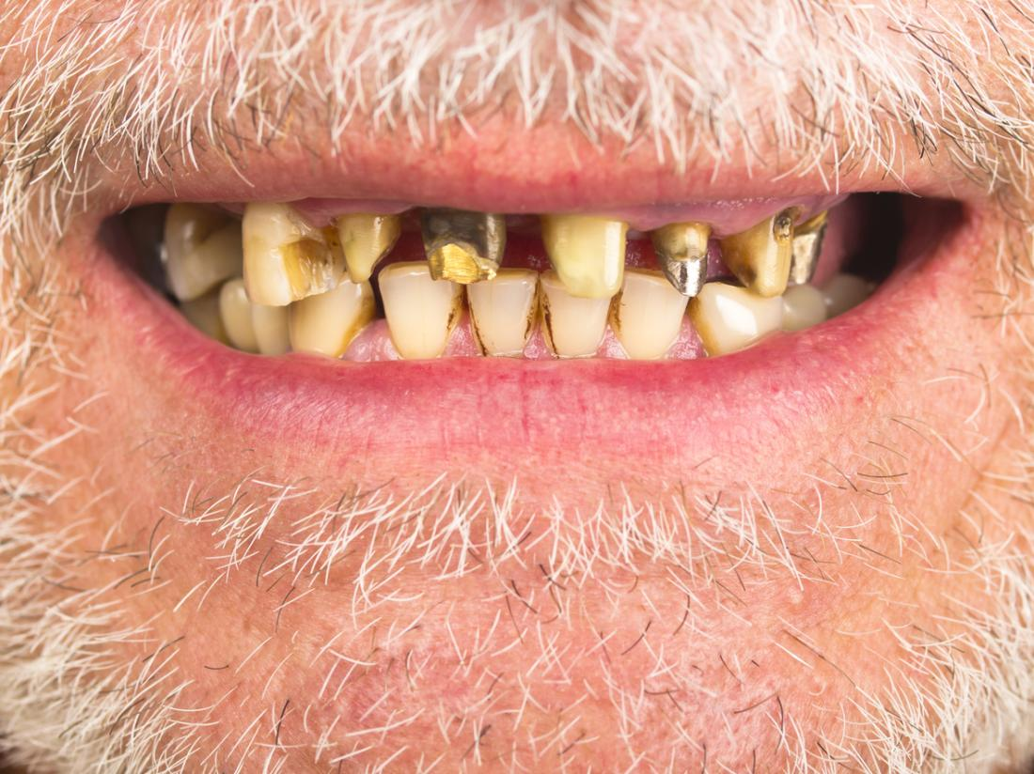
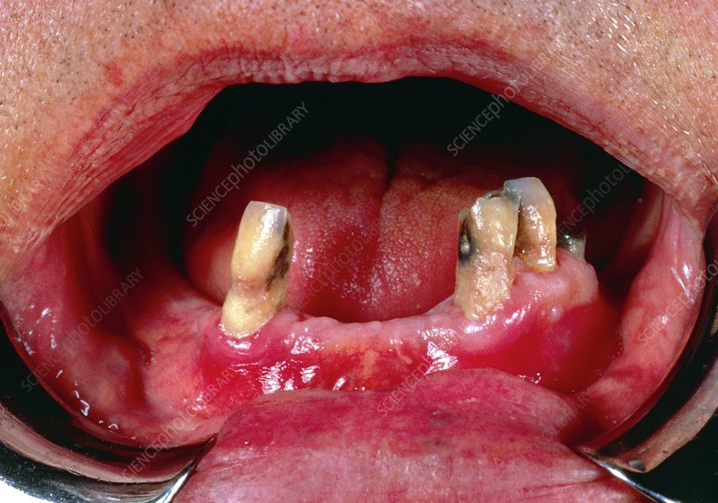

Slide 29
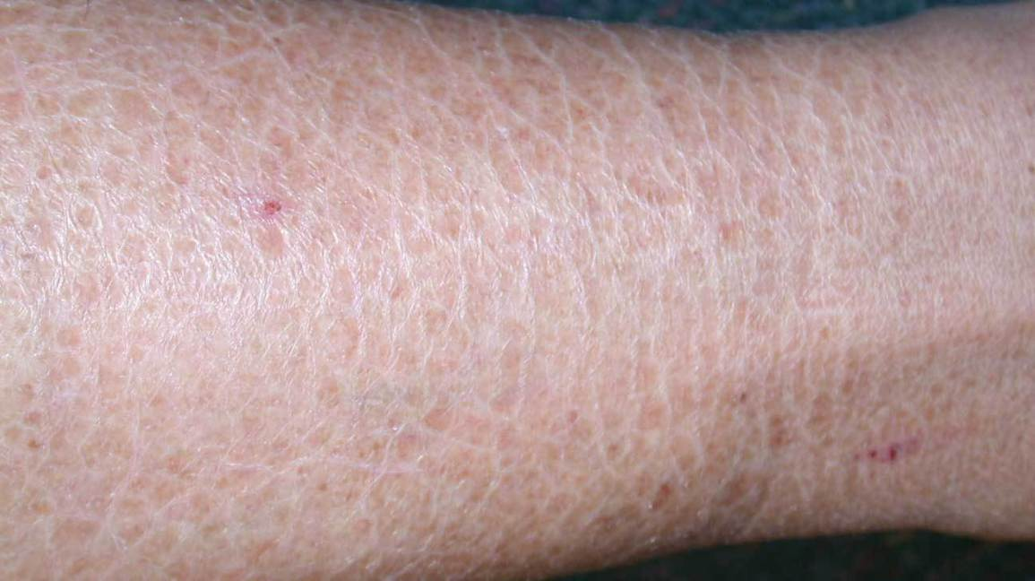

Slide 30
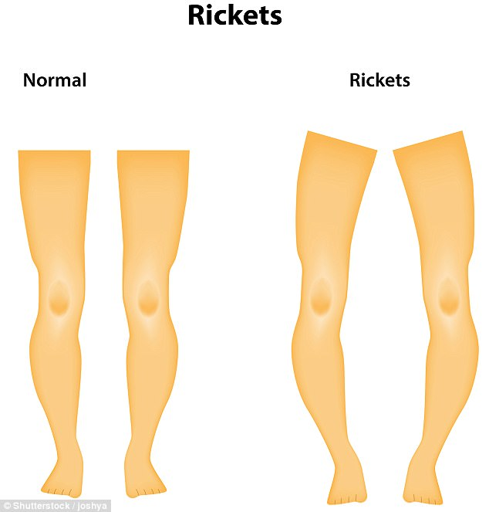

Slide 31
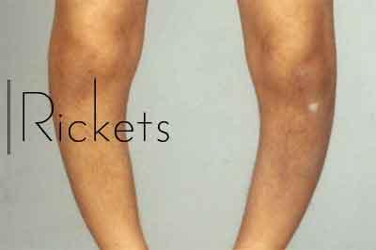

Slide 32
Balance diet
Balance diet contain right amount of carbohydrates , fats proteins , vitamins , minerals and fibre to provide energy to meet daily requirement .
Factors affecting the balance diet
Climate
Age
Gender
Occupation
Health

Slide 33
Food problems / famine
          Starvations Malnutrition / unbalance diet
Starvation is when a person or animal has not eaten food for such a time that they are unable to do things in a normal way
Malnutrition has two types
Over nutrition : when nutrition are in more supply than required
Under nutrition : when nutrition are in less supply than required

Slide 34
Factors lead to famine
Warfare
Earthquake, flood
Increasing population
Growing of bad crops
Unequal distribution of food

