Slide 1
States of matter

Slide 2
1.1.1 Kinetic Theory Solids, Liquids & Gases

Slide 5
1.1.2 States of Matter

Slide 11
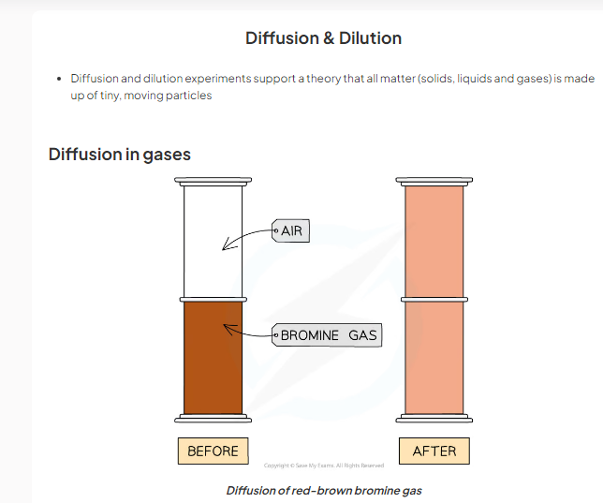
1.1.2 Diffusion & Dilution

Slide 12
\

Slide 23
Chapter 2
Atomic Structure

Slide 36
Isotopes

Slide 42
2.2.1 Ions & Ionic Bond

Slide 45
The Formation of Ionic Bonds

Slide 48
Electrostatic forces between the positive Na ion and negative Cl ion

Slide 51
Covalent bond

Slide 59
CH3OH

Slide 68
Describe the structure of silicon(IV) oxide (silicon dioxide).
In the silicon dioxide structure, each silicon atom is bonded to four oxygen atoms but each oxygen atom is bonded to two silicon atoms.Silicon dioxide has a similar structure to diamond. It forms very hard colourless crystals and has a high melting and boiling point.

Slide 72
Metallic bonding
Metal atoms are held together strongly by metallic bonding in a giant metallic lattice.

Slide 73
Metal atoms are held together strongly by metallic bonding in a giant metallic lattice.
Within the metallic lattice, the atoms lose the electrons from their outer shell and become positively charged ions.
The outer electrons no longer belong to a particular metal atom and are said to be delocalised.

Slide 76
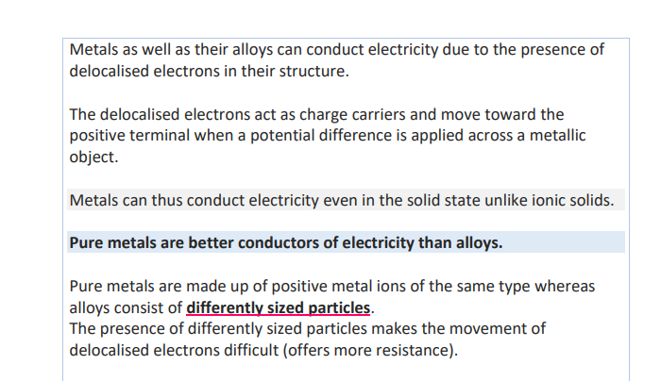

Slide 81
Chapter 3
Stoichiometry

