Slide 1
Ch:8-9
By: Mohammad Haseeb

Slide 2
NCA
Non-current assets are assets that:
1 were not bought primarily to be sold; but
2 are to be used in the business; and
3 are expected to be of use to the business for a long time.
Examples: buildings, machinery, motor vehicles, fixtures and fittings.
Non-current assets are listed first in the statement of financial position starting with those the
business will keep the longest, down to those which will not be kept so long.

Slide 3
CA
Current assets are assets that are likely to change in the short term and certainly within twelve
months of the date of the statement of financial position. They include items held for resale at a
accounts receivable, cash in the bank, and cash in hand, INVENTORY
These are listed in increasing order of liquidity - that is, starting with the asset furthest away from being turned into cash, and finishing with cash itself(Liquidity sequence). For instance:
Current assets
1 Inventory
2 Accounts receivable
3 Cash at bank
4 Cash in hand

Slide 4
Liabilities
There are two categories of liabilities, current liabilities and non-current liabilities.
Current liabilities
Current liabilities are items that have to be paid within a year of the date of the statement of financial position.
Examples: bank overdrafts, accounts payable resulting from the purchase on time of goods for resale, INTEREST PAYABLE
Non-current liabilities
Non-current liabilities are items that have to be paid more than a year after the date of the statement of financial position.
Examples: bank loans, loans from other businesses.

Slide 5
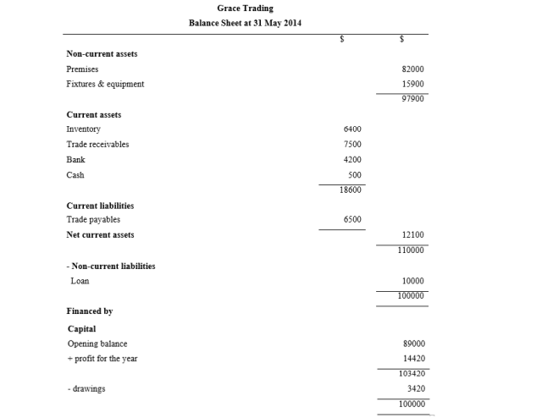
Balance Sheet/ Statement of Financial Statement Format (Vertical)

Slide 6
Notes
SEE PAGE 107-108 OF FRANK WOOD (132-133 IF USING ADOBE READER

Slide 7
Carriage
When goods are delivered by suppliers or sent to customers, the cost of transporting the goods is often an additional charge to the buyer. This charge is called 'carriage'.
When it is charged for delivery of goods purchased, it is called carriage inwards.
Carriage charged on goods sent out by a business to its customers is called carriage outwards.
carriage inwards is always added to the cost of purchases in the trading account.
Carriage outwards is always entered in the profit and loss account section of the statement of profit or loss. It is never included in the calculation of gross profit.

